Slide 1

Sustainable Development Goal 6: Water and Sanitation for All
Sustainable Development Goal 6 (SDG 6) aims to ensure the availability and sustainable management of water and sanitation for all. This goal addresses crucial water-related issues like access to clean drinking water, sanitation, and hygiene, impacting the well-being of billions globally.
AM
by Allan Mwangi

Slide 2
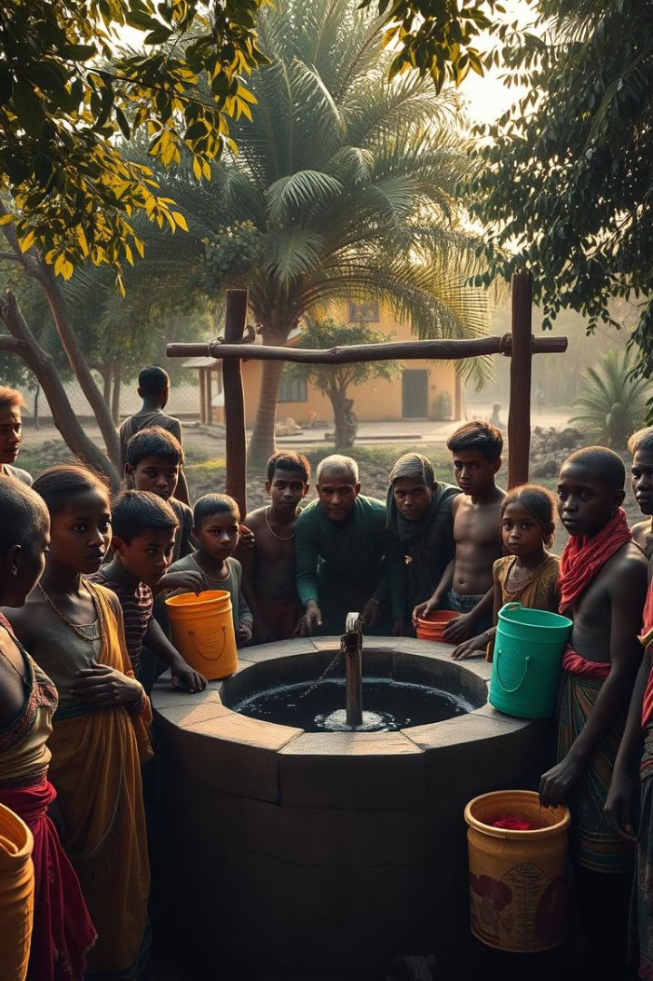
Problem Definition and Significance
1
Limited Access to Clean Water
2
Contamination Concerns
Many rural areas struggle with limited or poor-quality water sources, impacting their ability to access safe and clean drinking water.
Water contamination due to bacteria, chemicals, and heavy metals poses serious health risks and undermines access to safe drinking water.
3
Insufficient Monitoring and Intervention
Lack of regular water quality testing and monitoring, as well as delayed or ineffective interventions, exacerbate the issue of unsafe drinking water.

Slide 3
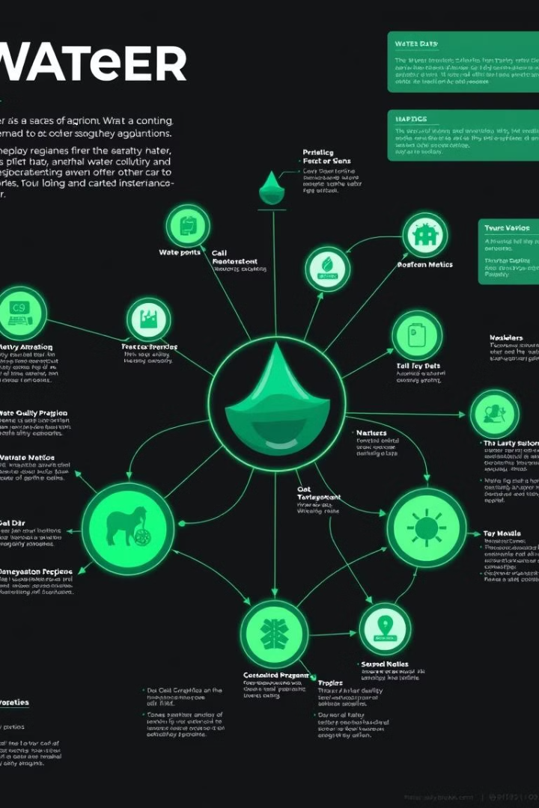
Database Design and Schema
Water Source Management
Water Quality Monitoring
Cataloging and assessing water sources, tracking their condition and reliability, is crucial for informed decision-making.
Regular water quality testing and tracking of results over time provide valuable insights into contamination trends and issues.
Intervention Management
Community Access Assessment
Recording and monitoring interventions like purification efforts and infrastructure repairs allow for effective evaluation and improvement.
Determining the level of access to clean water for different communities allows for targeted interventions and equitable resource allocation.

Slide 4
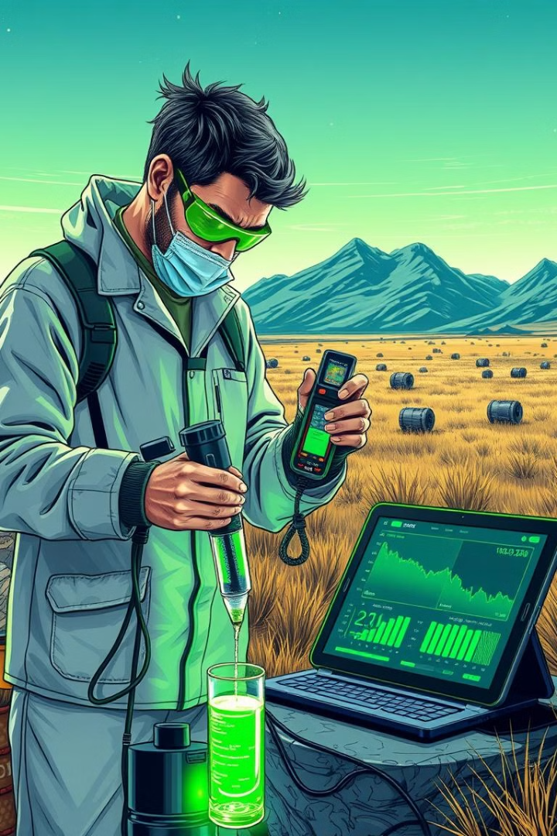
Data Collection and Cleaning
Data Category
Example Data Points
Community Information
Name, region, population, access to water
Water Source Details
Type, condition, location, associated community
Water Quality Test Results
Date, contaminants present, test outcomes
Interventions
Type, date, status, effectiveness

Slide 5
Data Analysis Insights
Data Retrieval Queries
Data Analysis Queries
Communities with No Access
Proportion of Polluted vs. Clean Sources
Water Sources in a Community
Average Contamination Levels by Source Type
Latest Test Results
Communities with Most Polluted Sources
Detailed Water Source Information
Number of Interventions and Status
Trend Analysis

Slide 6




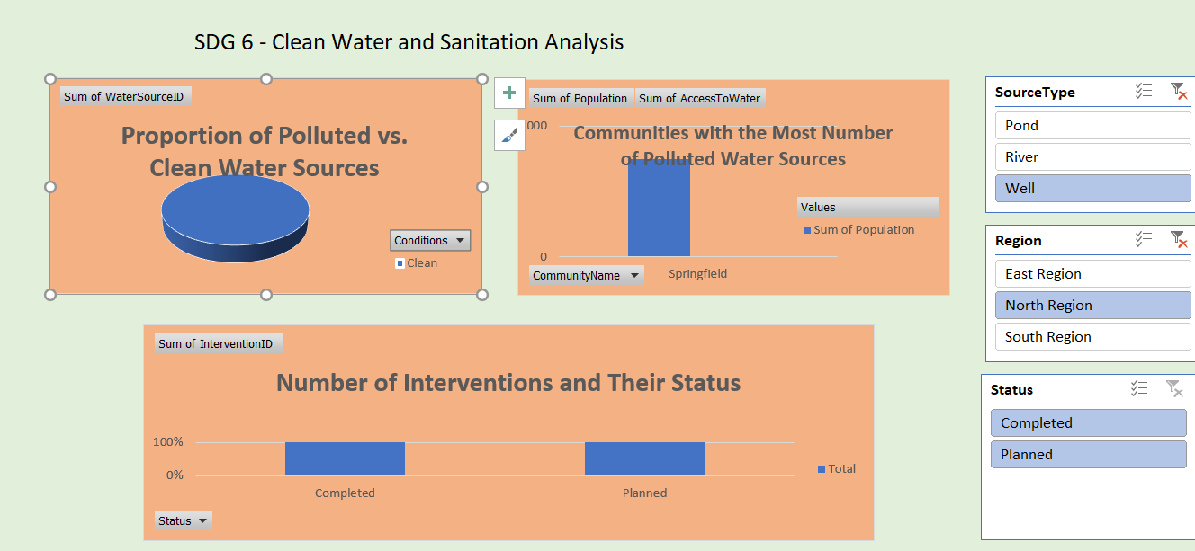

Excel Dashboard Demonstration
Analysis of Proportion of Polluted vs. Clean Water Sources
Analyze Average Contamination Levels by Source Type
Find Communities with the Most Number of Polluted Water Sources
Track the Number of Interventions and Their Status
Visually represents the distribution of clean and polluted water sources, highlighting areas of concern.
Shows average contamination levels across different water source types, identifying potential trends.
Identifies communities with the highest number of polluted water sources, enabling targeted interventions.
Monitors the number and status of interventions, assessing their impact on water quality.
Trend Analysis: Number of Safe vs. Unsafe Tests Over Time
Visualizes trends in water quality over time, revealing patterns and areas for improvement.

Slide 7
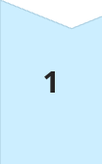
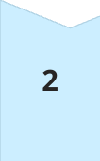
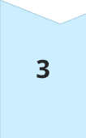

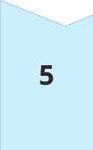
Recommendations and Next Steps
Identify Communities in Need
Pinpoint communities lacking access to clean drinking water based on data analysis.
Assess Water Source Condition
Evaluate the condition and reliability of water sources in identified communities.
Analyze Contaminants
Determine the types and levels of contaminants present in water sources.
Evaluate Interventions
Assess the effectiveness of past interventions and identify areas for improvement.
Prioritize Resources
Use data to prioritize resource allocation and actions for improving water access and quality.

Slide 8
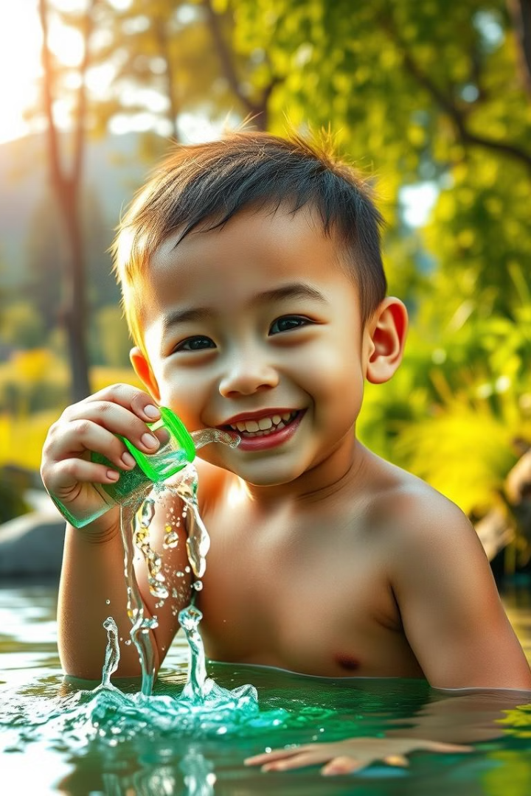
Conclusion
Achieving SDG 6 is crucial for improving access to clean water and sanitation, contributing to broader goals like reducing poverty, fostering economic growth, and sustaining ecosystems. By leveraging data-driven insights and implementing targeted interventions, we can create a more sustainable and resilient future where clean water and sanitation are accessible to all.
https://gamma.app/docs/Sustainable-Development-Goal-6-Water-and-Sanitation-for-All-jfse24srtsc72zm?mode=doc

